Slide 1
Volodymyr Mazur
Experienced FP&A Manager / Finance PM

Slide 2
About me
An energetic professional with over 15 years of experience
Went through many positions in finance from cost controller to FM/FD/CFO
Able to build motivated teams and deliver consistent results
Experience with highly dynamic, multinational settings
Keen on efficiency, process design, and integration

Slide 3
Industry expertise
Pharma & Healthcare
[big pharma & green field pharma projects]
7 years
IT
[services, media, SaaS]
6 years
Others
[audit, utilities]
4 years

Slide 4
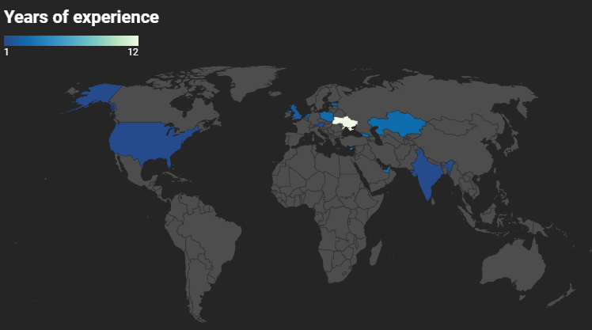
Exposure to jurisdictions
Ukraine 12
Cyprus 5
Georgia 3
UAE 3
Poland 3
Kazakhstan 3
USA 2
UK 2
Estonia 2
Netherlands 2
Hong Kong 2
Austria 1
India 1

Slide 5
Functional expertise
5 points
> Financial Planning & Analysis (including modeling, valuation and decision support)
> Reporting
4 points
> Team development
> Audits & controls
> International taxation
> Process management
> Project management
> Vendor management
2 points
> M&A
> IPO
Personal assessment (5 points scale)

Slide 6
Other Skills
Software:
> ERP & banking solutions > MS & Google suites
> Full stack BI advanced user (PowerBI, Tableau, Looker)
> SQL / Python
> Project management soft
> Collaboration tools
Attributes:
> Strategic thinker
> Problem solver
> Goal-oriented
> Collaborative
> Tech-savvy

Slide 7
Recent projects

Slide 8
Project description
Value delivered
Mindy Support (2020-21) >> legal-finance re-org of the service business (2000 contractors)
+3pp of GM improvement / increase of company competitiveness
Mindy Support (2021) >> SOC2 (Systems and Organizations Controls) type1 audit & report issue (IT security company-wide project)
ability to work with US-based large corporations / request from the potential client
ESW Capital (2018-19) >> design of the planning approach & model for the centralized functions of company ($150m/year of costs)
start of the planning cycles for centralized functions of highly dynamic IT SaaS business
DTEK Energy (2017-18) >> complex project (6 streams) inside the finance function of the company
most of the project deliverables were completed with quality / as per reqs
Group of private investors (2014-15) >> setup of the legal-finance infrastructure for the ambitious PPP project in Georgia
business case managed & presented to the partner in Georgia (gov fund), private partners contributions valued with Big4 (major in-kind investments), legal-finance infrastructure created

Slide 9
What you’ll get

Slide 10
Offering
Efficient FP&A function with continuous improvements, reliable and reusable solutions
Delivery of complex projects (not only in finance), including business transformations
Business support on all levels (from operational to strategic)
Can do mindset in the dynamic setting
Flow of ideas to improve the business

Slide 11

Contacts
Volodymyr Mazur
mazur.volodymyr@gmail.com
LinkedIn profile
+40-720-776-027

